Slide 1
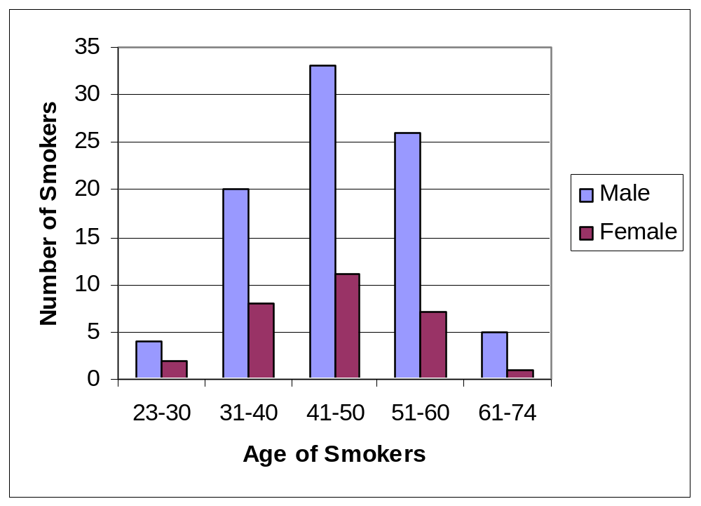
Describe the current incidence of male and female smoking in the UK.

Slide 2
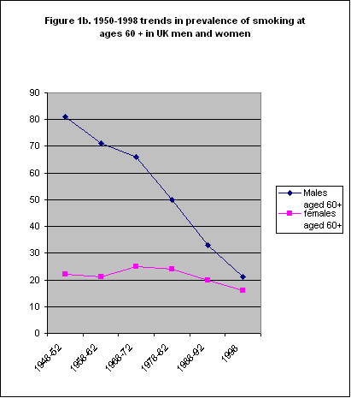
How has the prevalence of smoking changed from 1950 to 1998?

Slide 3
Which of your tables/graphs/diagrams give the strongest evidence to support/reject your hypothesis? How?
What conclusions can you draw from your table/graph/diagram? Convince me using the table/graph/diagram.
Are any of your graphs/diagrams difficult to interpret? Why?

